Slide 1

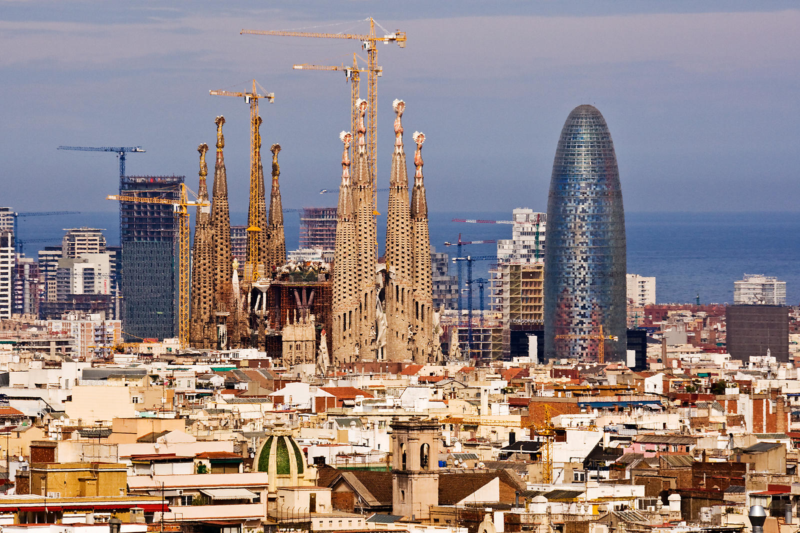

Buying Barcelona: Analyzing Property Affordability for Foreign Buyers in Spain A Data-Driven Look at Housing Affordability in Spain’s Most Sought-After City
Cory Golladay DSC 680 – Applied Data Science June 2025

Slide 2

Why This Project Matters
Barcelona’s housing market has become a hotspot for foreign investors.
Growing demand = rising prices = shrinking affordability.
This analysis asks:
How have prices changed?
Is Barcelona still affordable for foreign buyers?
What are the broader implications for locals and policy?
This isn't just a real estate issue. It's a question of access, equity, and economic sustainability.

Slide 3

Data Used in the Analysis
Idealista (Kaggle): Price, size, location, amenities
Numbeo: Net income, rent, price-to-income ratios
INE (Spain): Mortgage data, average income
ECB: Historical EUR exchange rates

Slide 4
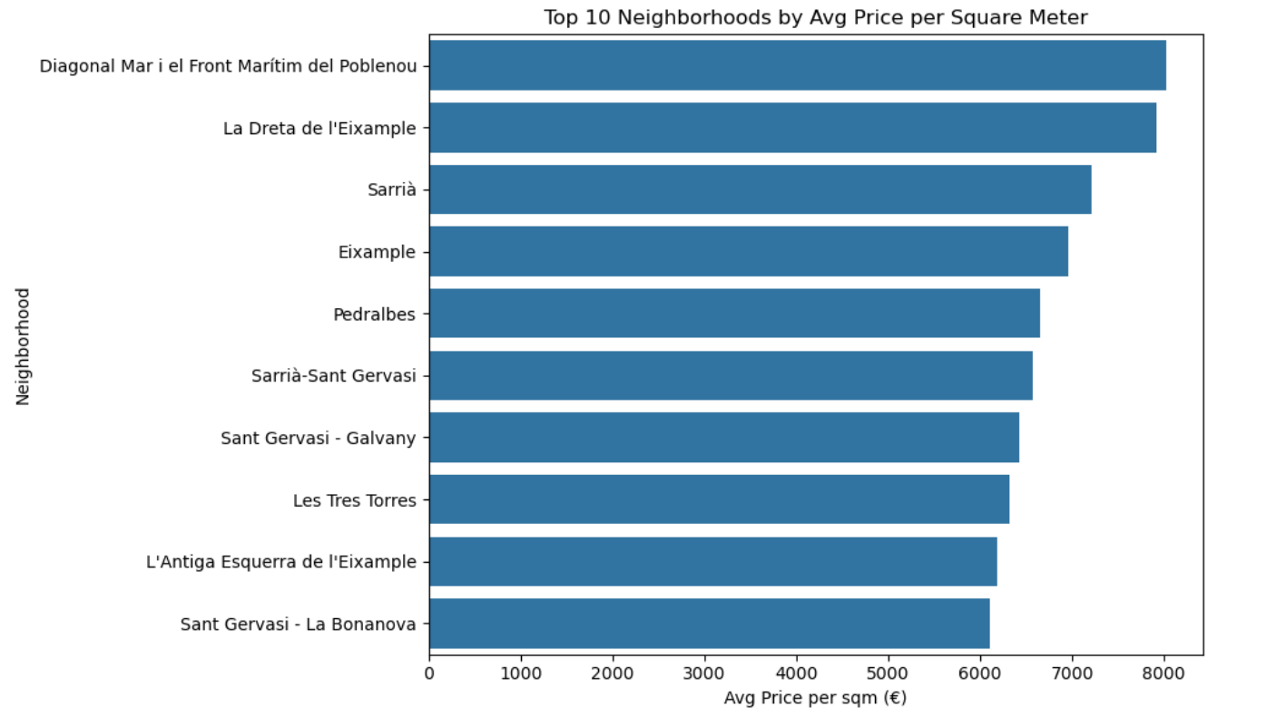
How I Approached the Problem
Price per square meter calculated
Visuals: Histogram, Boxplot by Neighborhood
Income vs. price ratio to assess affordability
Used Numbeo metrics for average income, mortgage burden

Slide 5
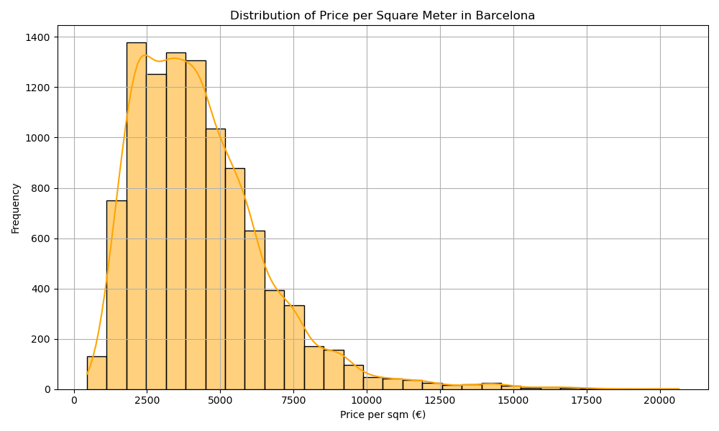
Price per Sq. Meter – Distribution

Slide 6
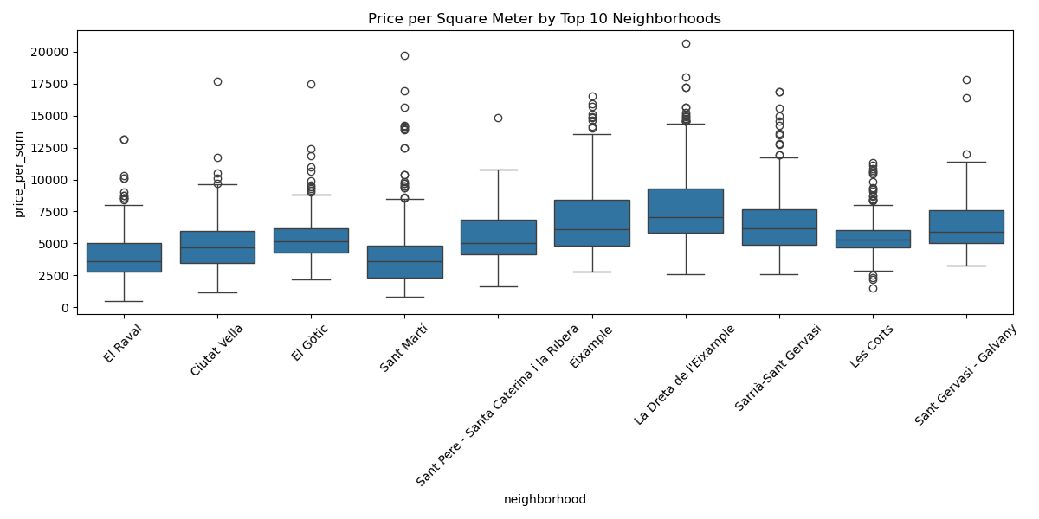
Neighborhood Comparison

Slide 7
Can the Average Buyer Afford a Home?
Avg. property price: €530,460
Avg. monthly income: €1,851
Years of income to buy: ~24 years
Mortgage as % of income: 88.9%
Affordability Index: 1.12 → strained

Slide 8
What the Data Tells Us
Barcelona is increasingly unaffordable for the average buyer.
Foreign buyers with strong currency may find opportunities.
Locals face higher mortgage burdens and limited housing access.
Affordability varies greatly by neighborhood.

Slide 9
Ethical Questions
Does analysis risk encouraging gentrification?
Are we favoring foreign investment over local stability?
Care taken to:
Avoid biased framing
Use public data only
Contextualize results neutrally

Slide 10
What Can Be Done?
Local gov't: Limit speculative investment, support affordable housing
Urban planners: Use affordability heatmaps in zoning decisions
Real estate agents: Help ethical investors find undervalued areas

Slide 11
Anticipated Questions & Answers
How do you define affordability? → Price-to-income ratio, years to purchase
Why Barcelona? → High-interest location with rich open data
Does this include exchange rate impacts? → Not in final model
What’s missing? → Time-stamped listings, richer foreign income data
Can this be applied to other cities? → Yes—Madrid, Valencia, Lisbon

Slide 12
Access the Code & Data
Notebook file: DSC680_Project1_CoryGolladay.ipynb
CSV file: clean_data.csv
Visuals: histogram, boxplot
All deliverables uploaded to Blackboard
GitHub:

